Slide 1

ADVANCED PROGRAMMING LANGUAGE
KOTLIN

Slide 2

TEAM MEMBERS
KOTLIN Project
SAI CHARAN CHOWDARY KOMMI
DARSHIL PATEL
SAI ROSHAN REDDY PASULA
ABHINAY SAI KANCHARLA
AARYAN SANYASI MUDADI

Slide 3

Names, Binding, and Scopes
Names: Names in Kotlin are used to identify variables, functions, classes, objects, etc. They help us refer to these entities in our code. Names must follow certain rules, such as starting with a letter or underscore, and can contain letters, digits, and underscores.
Binding: Binding is the association between a name and an entity. In Kotlin, most binding is static, meaning that it occurs at compile time. However, polymorphic calls use dynamic binding, which occurs at runtime.
Scopes: Scope defines the visibility and lifetime of a name. Kotlin has several types of scopes:
Local Scope: Defined within a block or function.
Function Scope: Defined within a function.
Class Scope: Defined within a class.
Package Scope: Defined within a package.
Global Scope: Accessible throughout the program.

Slide 4

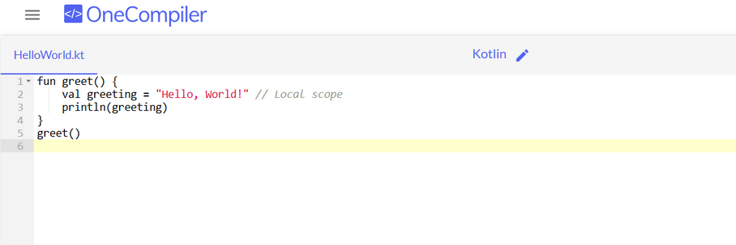
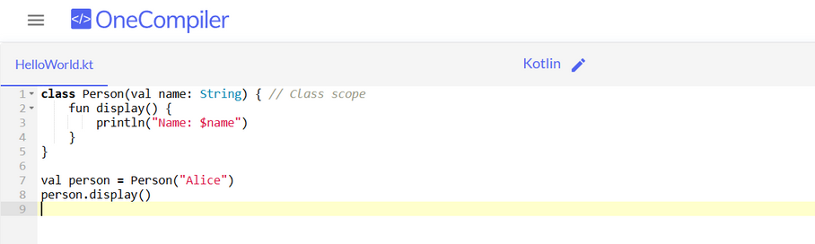
Code 1: The variable greeting is defined within the greet function and is accessible only within this local scope.
Code 2: The class Person has a property name that is accessible within the class scope. The display function prints the name.

Slide 5

Data Types
Primitive Data Types: Kotlin provides several primitive data types, including Int, Double, Float, Long, Short, Byte, Boolean, and Char. These types are used to store numerical values, characters, and boolean values.
Strings and Arrays: Kotlin has a rich string handling mechanism, allowing easy manipulation and operations on strings. Arrays are used to store multiple values of the same type in a single variable.
Nullable vs Non-nullable Types: One of Kotlin's key features is null safety. By default, variables cannot be null. However, you can declare a variable as nullable by appending a question mark (?) to its type.

Slide 6
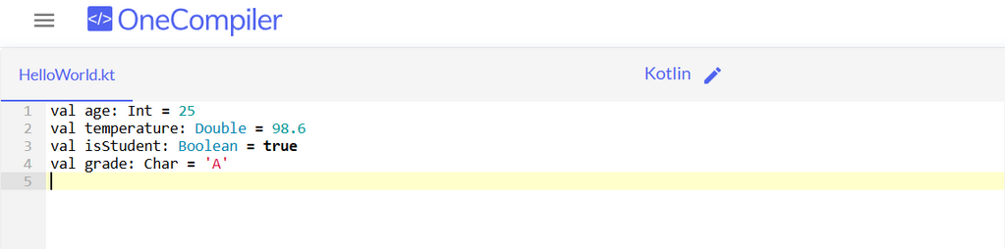
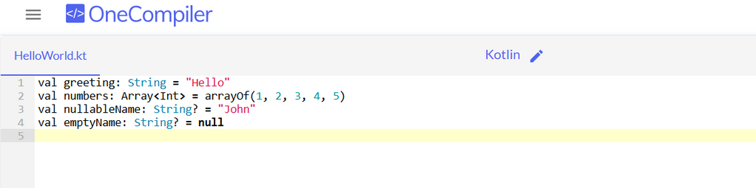
Code 1: This snippet defines variables with different primitive data types: Int, Double, Boolean, and Char.
Code 2: Here we see examples of a string, an array, and nullable types in Kotlin.

Slide 7

Expressions and Assignment Statements
Expressions: In Kotlin, an expression is a piece of code that evaluates to a value. Examples of expressions include arithmetic operations, function calls, and conditional expressions. Expressions can be used in variable assignments, return statements, and more.
Assignment Statements: Assignment statements are used to assign a value to a variable. The assignment operator (=) is used for this purpose. Kotlin also supports compound assignment operators, such as += and -=.
Conditional Expressions and Loops: Kotlin's if and when statements can be used as expressions, meaning they return a value. Loops, such as for and while, are used to repeat a block of code multiple times.

Slide 8
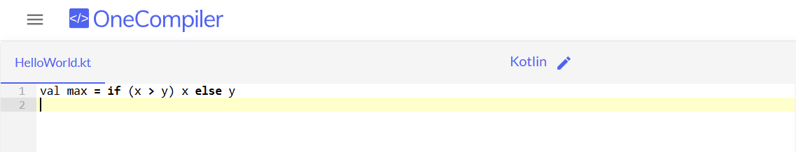
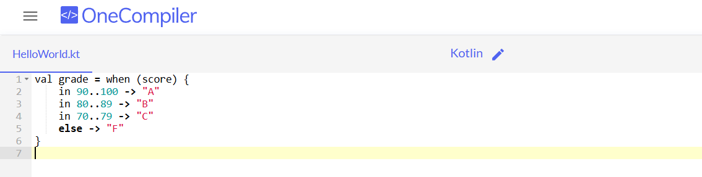
Code 1: This code uses an if expression to assign the maximum value of x and y to the variable max.
Code 2: The when expression assigns a grade based on the value of score.

Slide 9

Support to OO Programming
Classes and Inheritance: Kotlin fully supports object-oriented programming (OOP) with classes, inheritance, and polymorphism. You can define classes, create objects, and use inheritance to extend existing classes.
Polymorphism: Polymorphism allows a class to be treated as an instance of its parent class. This enables dynamic method binding and runtime flexibility.
Encapsulation: Encapsulation is achieved by using visibility modifiers such as private, protected, and public. It restricts access to the internal state of an object.
Advanced Features: Kotlin introduces advanced OOP features such as data classes (for storing data), sealed classes (for representing restricted class hierarchies), and delegation (for code reuse).

Slide 10
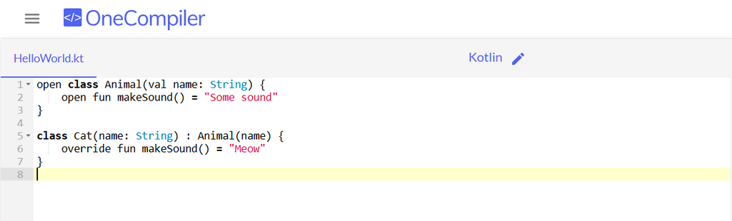
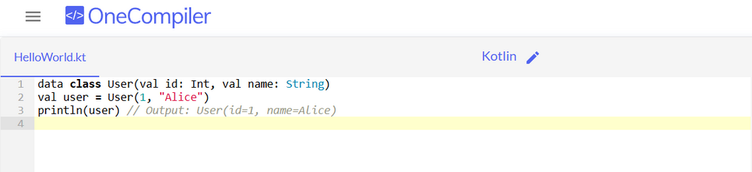
Code 1: The Cat class inherits from Animal and overrides the makeSound method.
Code 2: The User data class automatically provides useful methods like toString().

Slide 11

Concurrency
Coroutines: Kotlin's coroutines provide a simple and efficient way to manage concurrency. Coroutines are lightweight threads that can be easily managed and suspended without blocking the main thread.
Launch and Async: launch and async are coroutine builders that help create coroutines. launch is used for fire-and-forget tasks, while async is used for tasks that return a result.
Suspend Functions: A suspend function is a function that can be paused and resumed at a later time. It allows long-running tasks to be executed without blocking the main thread.

Slide 12
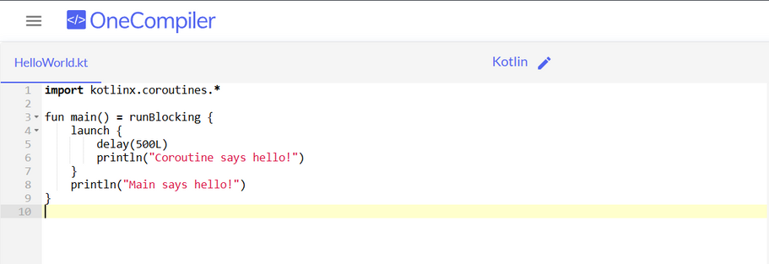
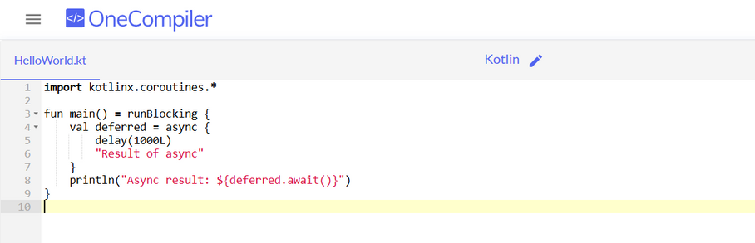
Code 1: A coroutine launched within runBlocking delays for 500 milliseconds before printing a message.
Code 2: An async coroutine returns a result after a delay and await is used to get the result.

Slide 13
Exception Handling and Event Handling
Exception Handling: Kotlin uses try-catch blocks to handle exceptions. The try block contains code that might throw an exception, and the catch block handles the exception.
Event Handling: Kotlin allows event handling through lambdas and higher-order functions. You can set event listeners that execute a block of code when an event occurs.

Slide 14
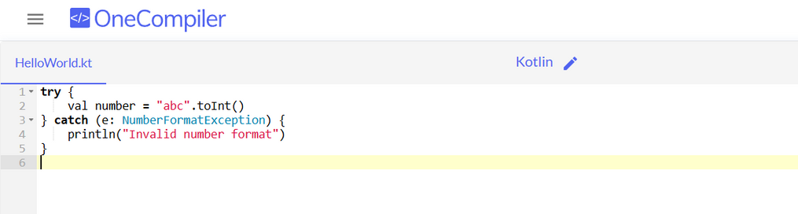
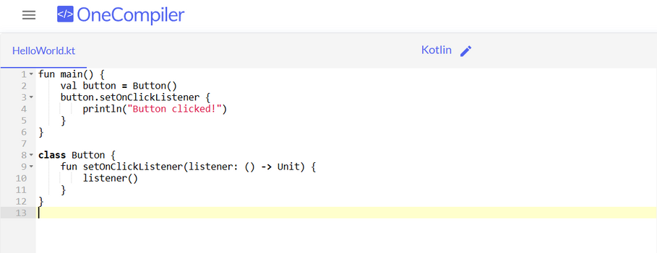
Code 1: This code tries to convert a string to an integer, and catches a NumberFormatException if the conversion fails.
Code 2: A lambda expression is used as an event listener for a button click.

Slide 15

Functional Programming
Higher-Order Functions: Higher-order functions are functions that take other functions as parameters or return functions as results. They enable functional programming in Kotlin.
Lambda Expressions: Lambda expressions are anonymous functions that can be used as parameters or return values. They provide a concise way to represent functional logic.
Collections Operations: Kotlin provides a rich set of functions for performing operations on collections, such as map, filter, and reduce.

Slide 16
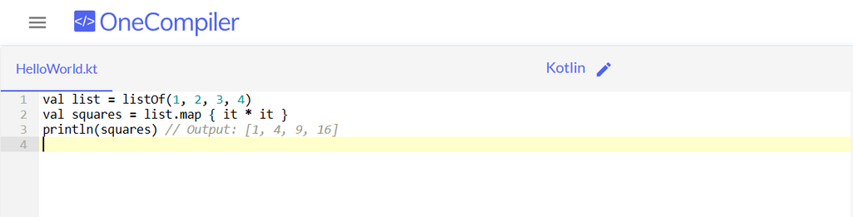
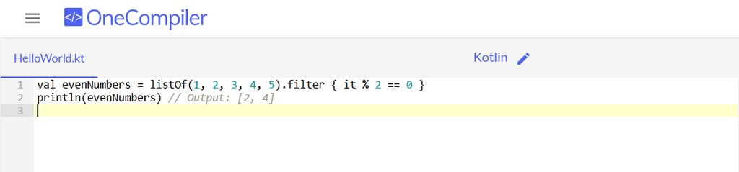
Code 1: The map function is used to create a new list containing the squares of the original list elements.
Code 2: The filter function creates a new list containing only the even numbers from the original list.

Slide 17



Objective:
Create a mobile app for managing daily tasks and schedules.
Project Definition
Constraints:
Must run on both Android and iOS.
Should sync data across devices.
Exploring Kotlin
Technology:
Kotlin for app development.
Firebase for backend and data sync.

Slide 18


Features
Task creation and management.
Schedule reminders.
Integration with calendar apps.
Cloud synchronization.
Application
This project can be applied to individuals and organizations looking to streamline task management and scheduling processes.

Slide 19
Thank you very much!

